Slide 1

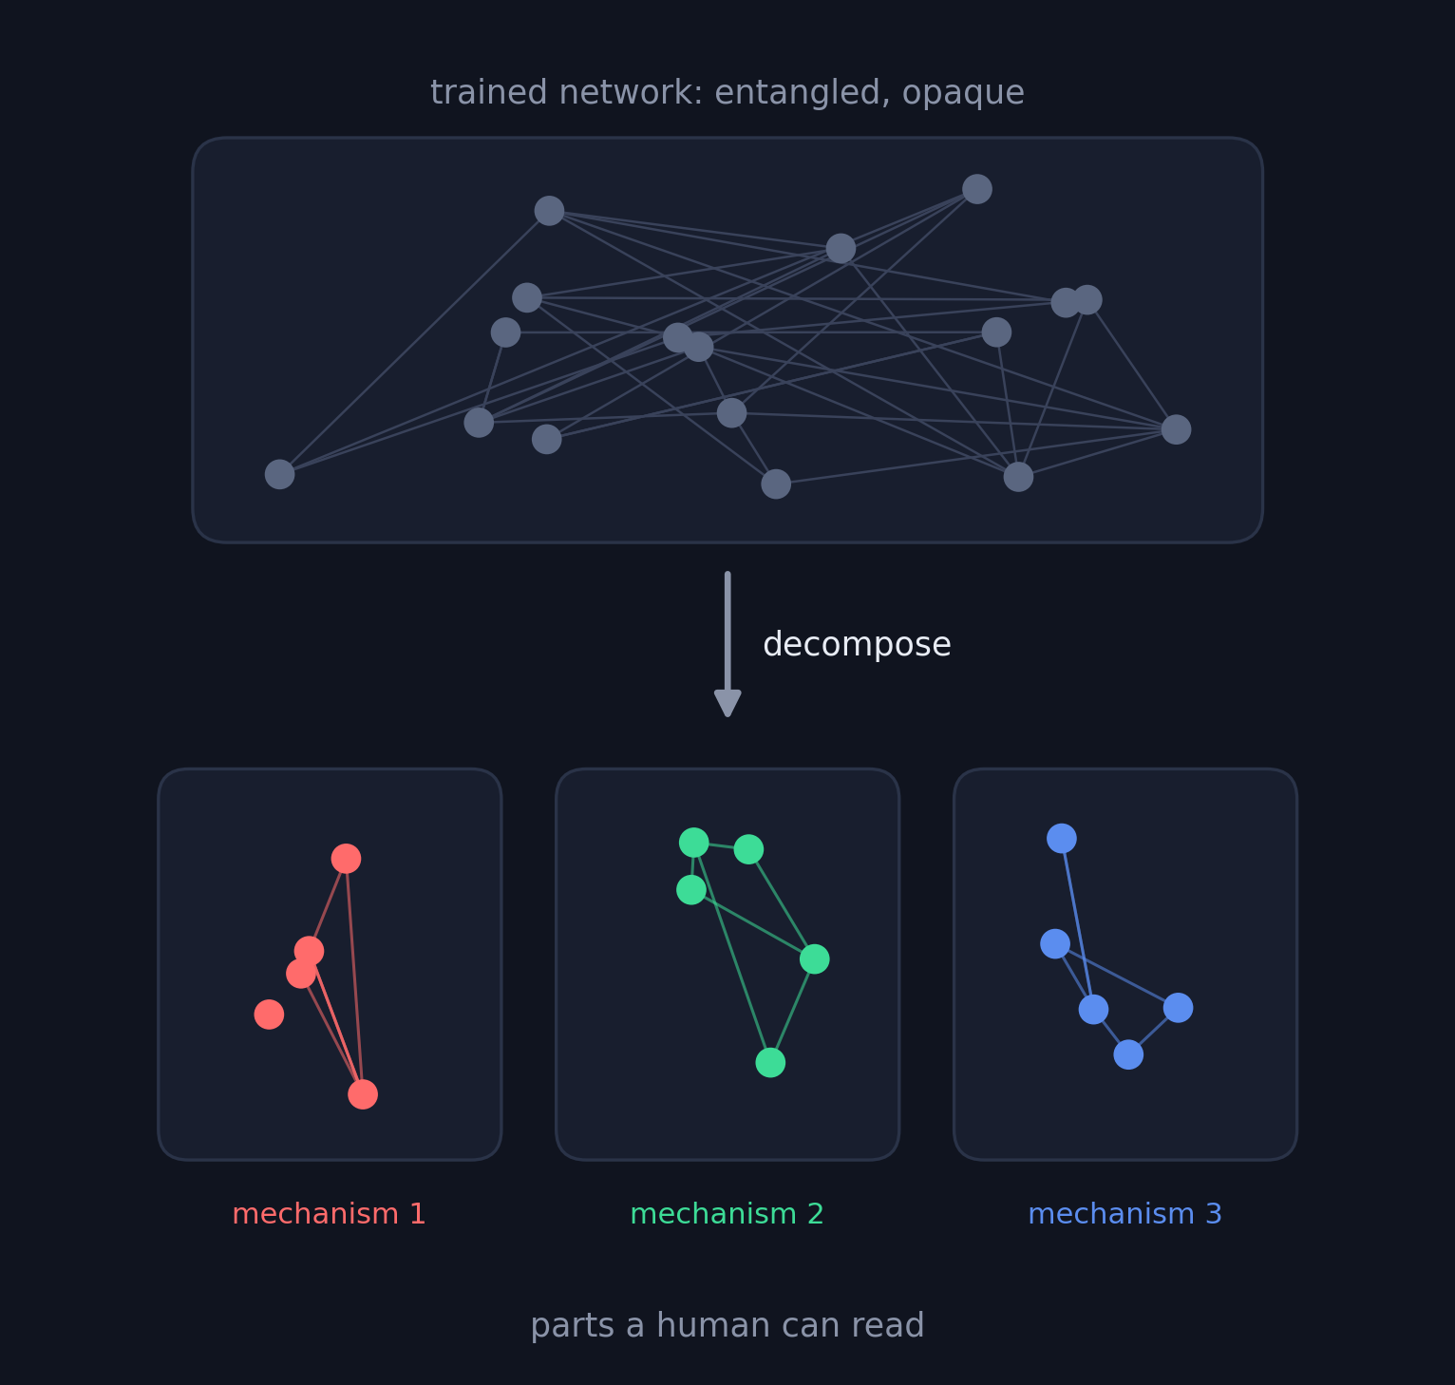

What is mechanistic interpretability?
Reverse-engineering neural networks into humanly interpretable parts
Neural networks work, but we cannot isolate specific concepts within them.
Mechanistic interpretability searches for the network's internal units of computation.
If we can name the parts, we can audit models for safety, edit behavior, and learn the algorithms the network discovered.
Notes:
Framing slide. Networks are grown, not engineered: training gives us weights that work, with no documentation. Mechanistic interpretability is the project of recovering that documentation: finding internal units (features, circuits, mechanisms) with a describable role. Motivations: safety auditing before deployment, targeted model editing, and scientific understanding of learned algorithms.

Slide 2
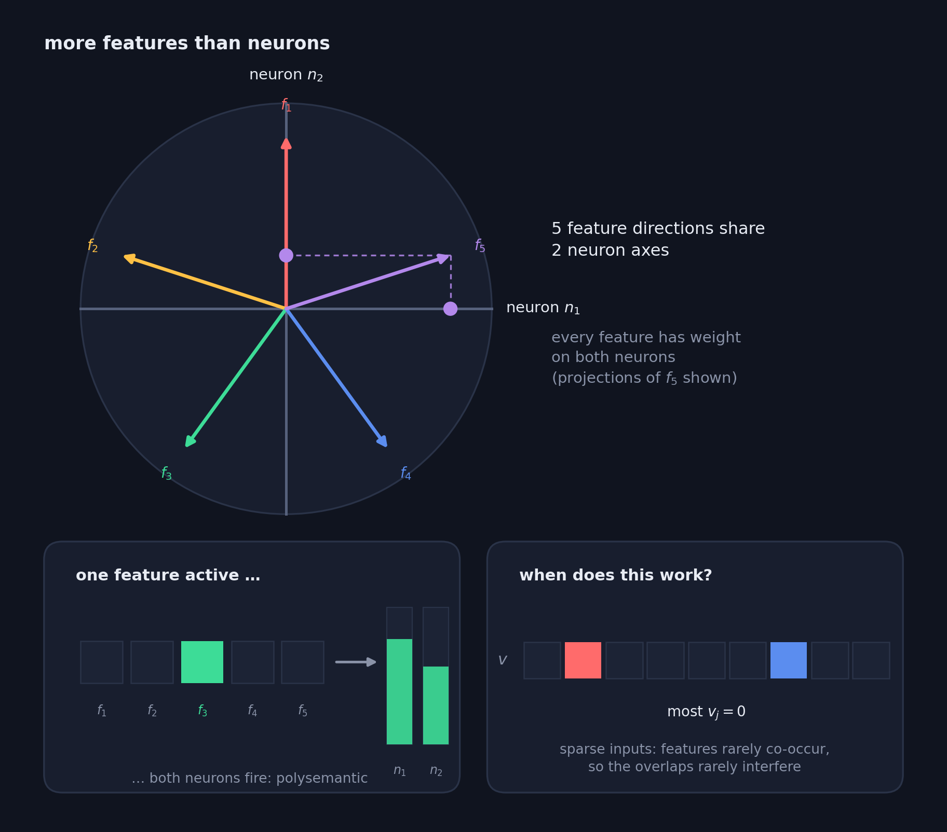

Hurdles to interpretability
Polysemanticity and the superposition hypothesis
The superposition hypothesis: networks represent more features than neurons by encoding features in an overcomplete basis in activation space.
Polysemantic neurons: Consequently individual neurons respond to multiple different features.
Notes:
Why reverse-engineering is hard, in one picture. Top panel: five feature directions live in a two-neuron activation space, with the neuron axes drawn in; every feature direction has nonzero projection on both axes (shown for f5). Bottom-left: the consequence is polysemanticity: activate a single feature and both neurons fire, so each neuron responds to multiple different features. Bottom-right: the regime where this is viable: superposition arises when inputs are sparse, with most entries v_j equal to zero, so the overlapping directions rarely interfere.

Slide 3
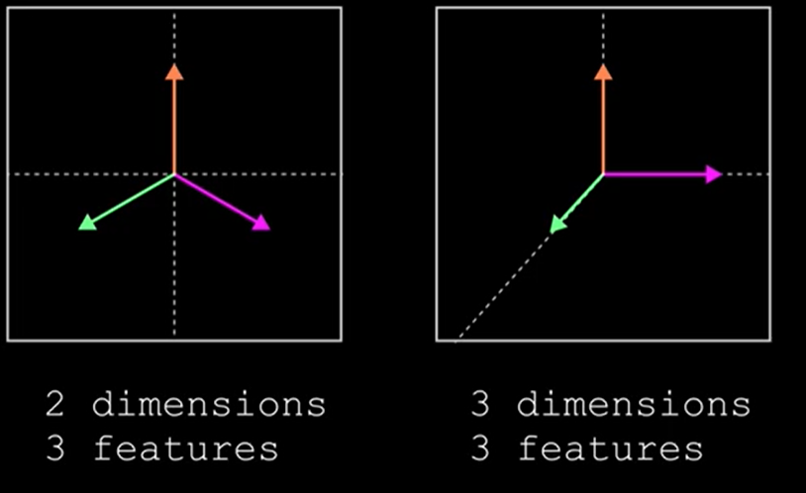
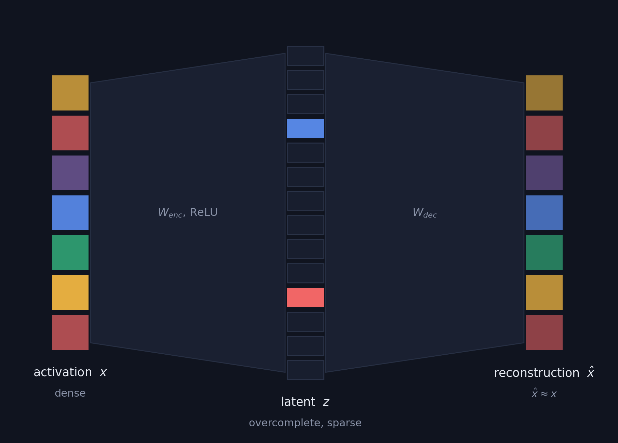

Sparse autoencoders
The dominant approach in activation space
Project the layer output to a sparse higher dimensional space.
z = ReLU(W_{enc} x + b_{enc})
x̂ = W_{dec} z + b_{dec}
L = ‖x − x̂‖² + λ‖z‖₁
Reconstruction keeps z faithful; the ℓ₁ penalty keeps it sparse. Each surviving latent is read as one candidate feature.
If we can find an isolated concept in the latent z, then we can clamp it to modify a network concept.
Notes:
SAEs decompose activations: encode an activation vector into a much wider latent space with an L1 sparsity penalty, decode back. Active latents are interpreted as features. This found many interpretable directions, but note what the object of study is: a second model trained to imitate the activations, not the network's own weights.

Slide 4
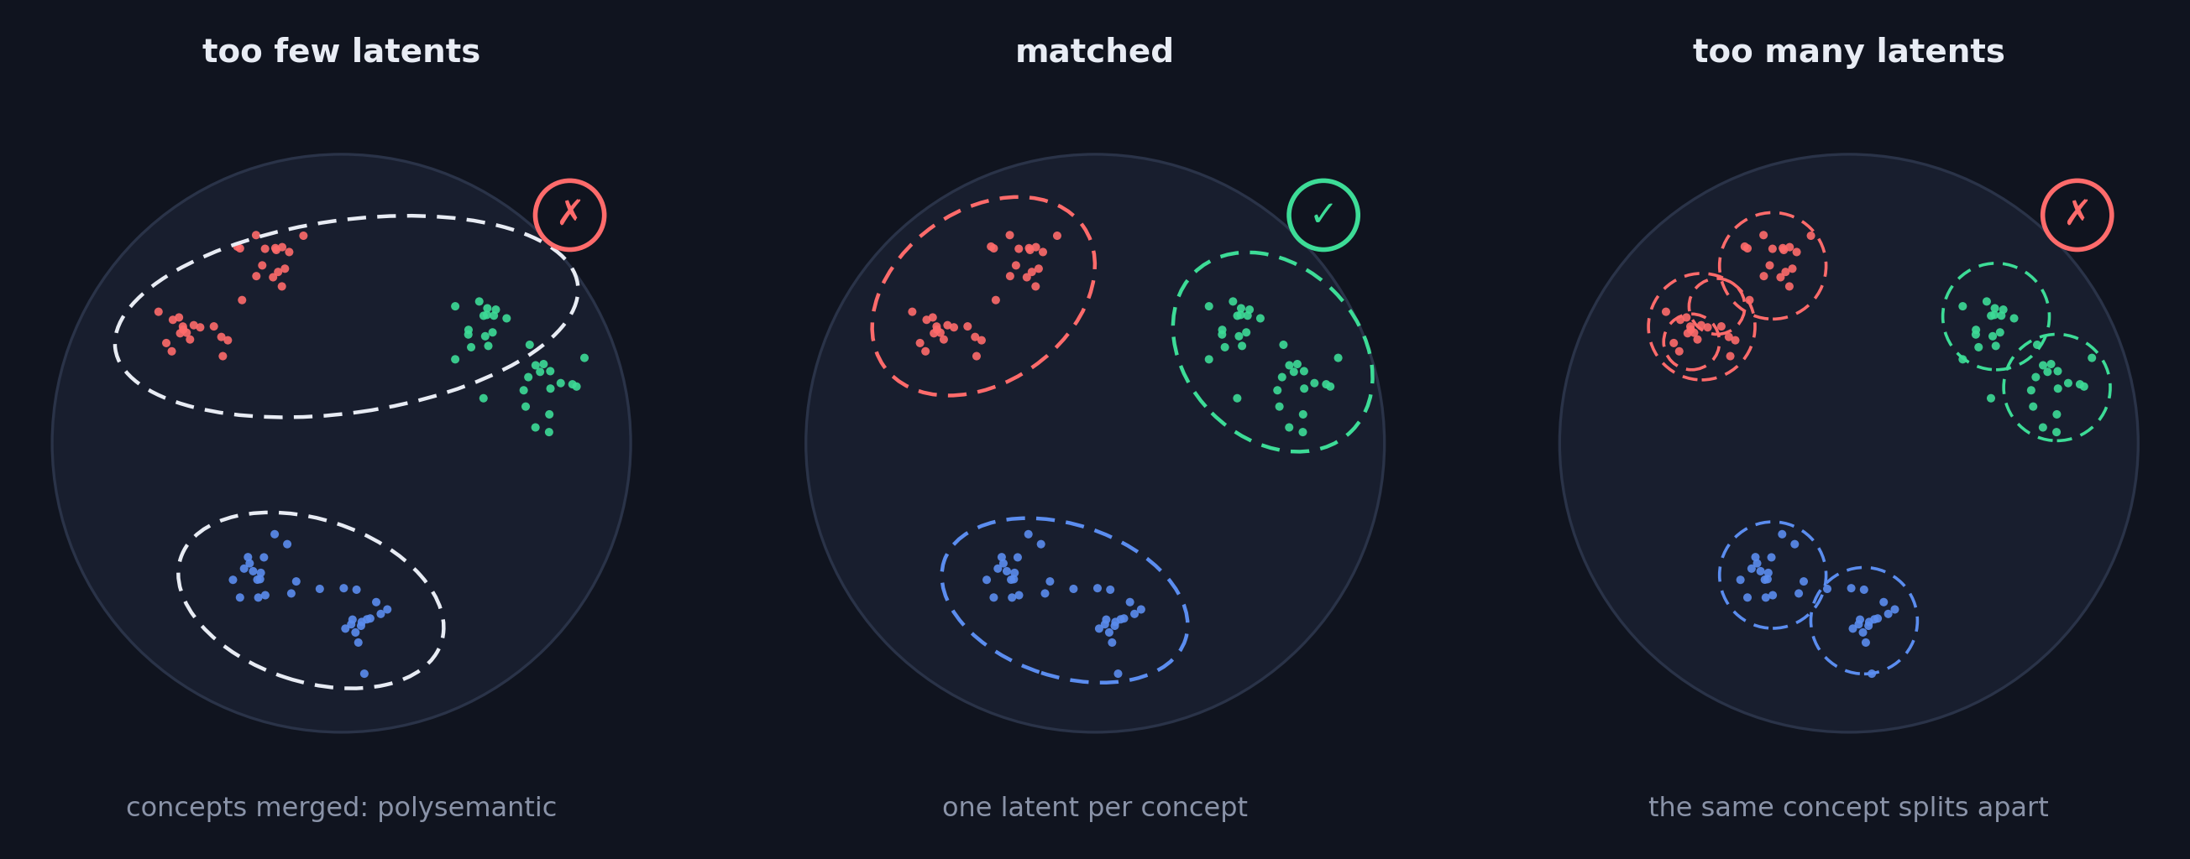

Limitations of sparse autoencoders
Feature absorption: Too large latent space, creates features with high precision but low recall.
Feature shrinkage: ℓ₁ penalty creates features that are smaller than in the original network.
Notes:
Two structural problems. First, measured feature quality: latents have imperfect precision (fire off-concept) and recall (miss on-concept activations). Second, the decomposition is not unique: it is a property of the SAE, not of the model. With too few latents, distinct concepts get merged into polysemantic latents; with too many, a single concept shatters into near-duplicates (feature splitting). There is no principled way to pick the dictionary size.

Slide 5
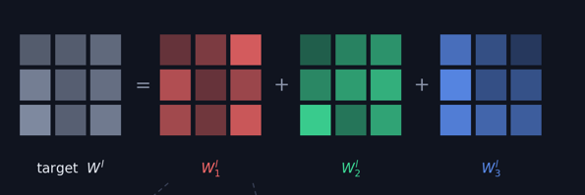
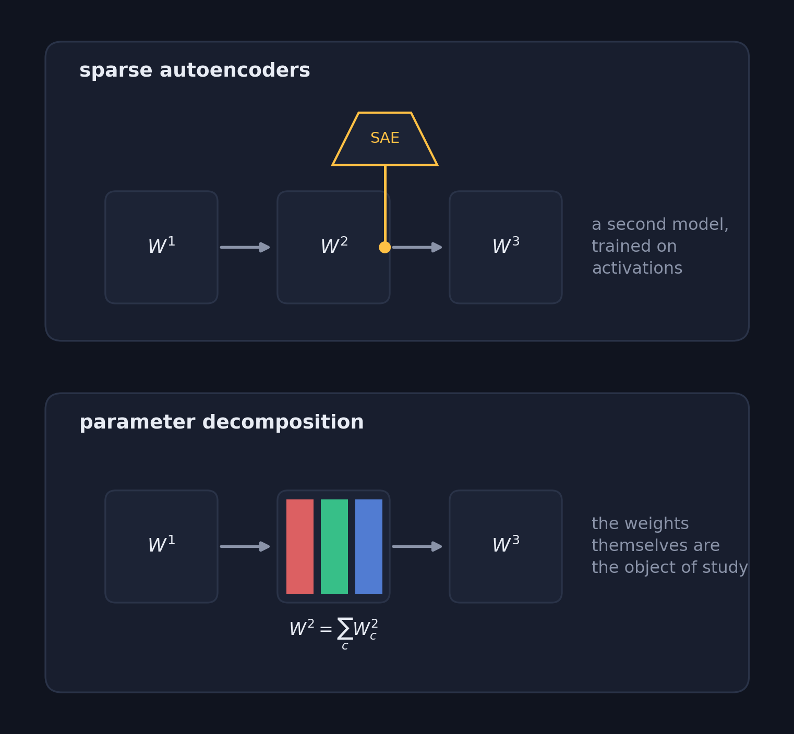

Parameter decomposition
Directly tied to the weights: no second model trained to imitate activations.
Write every layer of the trained model as a sum of components, each implementing one mechanism:
W^{l} = Σ_{c} W^{l}_{c}
A component is a mechanism if it is:
Faithful: the subcomponents sum to the original weights.
Minimal: as few subcomponents as possible are used to replicate the network output.
Simple: each component is low-rank
Notes:
Definition slide (Braun et al., 2025: APD). For each weight matrix W^l, find subcomponents W^l_c that sum back to it, with each block implementing one mechanism. Each block is itself constructed from a pair of factors U and V; in the rank-1 case W^l_c = U_c V_c^T is an outer product. The three desiderata: faithfulness (blocks sum to the target weights), minimality (per input, few blocks are causally used) and simplicity (each block is individually low-complexity, e.g. low-rank). APD optimised these directly via attributions but was costly and hyperparameter-sensitive, which motivates SPD on the next slide.

Slide 6
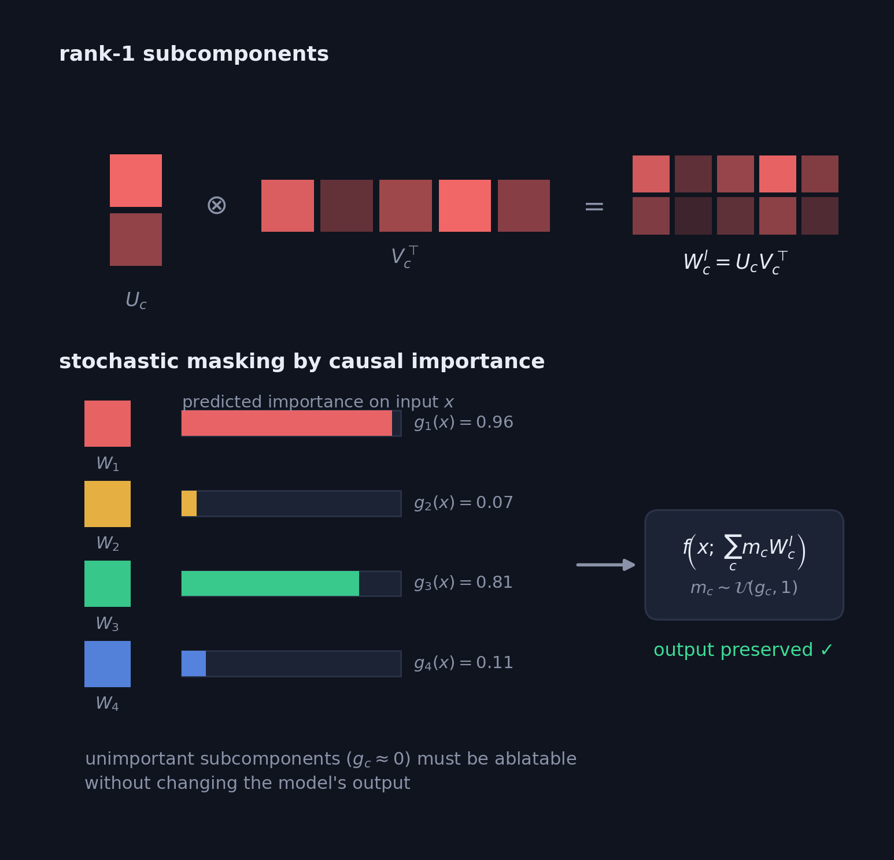
SPD: how the decomposition is learnt
Stochastic Parameter Decomposition (Bushnaq et al., 2025)
Each matrix is split into rank-1 subcomponents, possibly more than its rank; full components are clusters of these.
A learnt causal-importance function g_{c}(x) predicts whether a subcomponent is important for the computation of an input.
Trained with three losses:
Faithfulness: subcomponents sum to the target weights
Stochastic reconstruction: ablate subcomponents if they don’t contribute to the output
Minimality: minimize the amount of causally important subcomponents
Notes:
SPD mechanics. Every weight matrix is parametrised as a sum of rank-1 blocks W^l_c = U_c V_c^T. A small learnt network outputs a causal importance g_c(x) in [0,1] for each subcomponent on each input, crucially predicted per subcomponent, independently. Masks are sampled m_c ~ U(g_c, 1): important subcomponents stay, unimportant ones are randomly ablated, and the masked model must still reproduce the output (stochastic reconstruction). Faithfulness ties the sum to the original weights, and importance minimality pressures g to be sparse. No top-k hyperparameter, no attribution pass: this is what makes it more scalable and robust than APD.

Slide 7
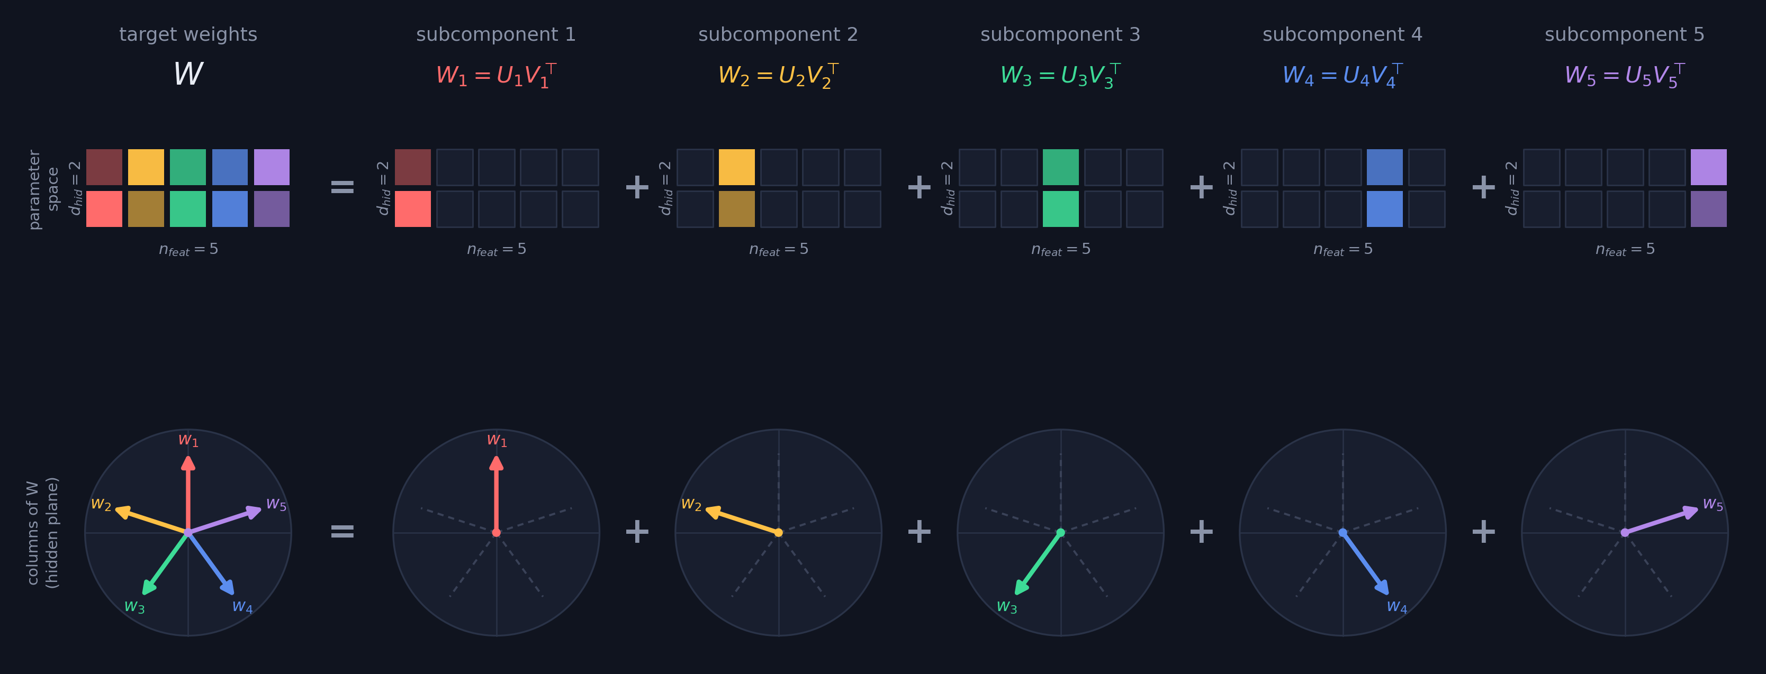
The toy model of superposition (TMS 5-2)
Five sparse features through a two-dimensional bottleneck
x̂ = ReLU(WᵀWx + b): Trained to learn an orthonormal transformation; however no inverse exists.
Superposition: W spreads the features as orthogonally as possible: its columns form a polytope
Notes:
The standard testbed (Elhage et al., 2022). Five features, each rarely active, are compressed through a 2-dimensional hidden layer with tied weights and reconstructed through a ReLU. Since 5 directions cannot be orthogonal in R^2, the model places them at 72-degree intervals: the pentagon. Ground-truth mechanisms are known here, one per feature. That makes it the perfect model for testing whether a decomposition method recovers the right parts.

Slide 8
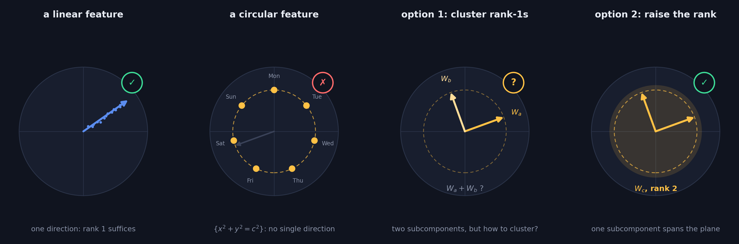
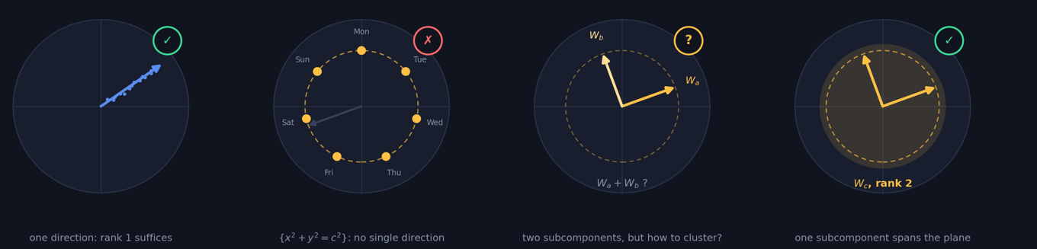


Why rank 1 might be insufficient
Not all language model features are linear (Engels et al., 2024)
The linear representation hypothesis does not apply to every feature: Some network concepts lie in a higher dimensional subspace.
Multidimensional features in various models: RNNs represent features by magnitude, transformers represent days of the week and modular arithmetic in higher dimensional spaces.
Options: Cluster subcomponents after training or increase the rank of subcomponents.
Notes:
The pivot of the talk. SPD's rank-1 subcomponents implicitly assume the linear representation hypothesis: one feature, one direction. But Engels et al. (2024) showed that some features are irreducibly multidimensional: days of the week and months of the year form circles in GPT-2 and Mistral, and RNN work finds circular representations of the form x^2+y^2=c^2. No single direction captures a circle. If the decomposition should stay faithful to such features, there are two options: keep rank-1 subcomponents and cluster them into multidimensional components (but the clustering problem is unsolved), or let a single subcomponent have higher rank and span the feature's subspace: the route this thesis takes.

Slide 9
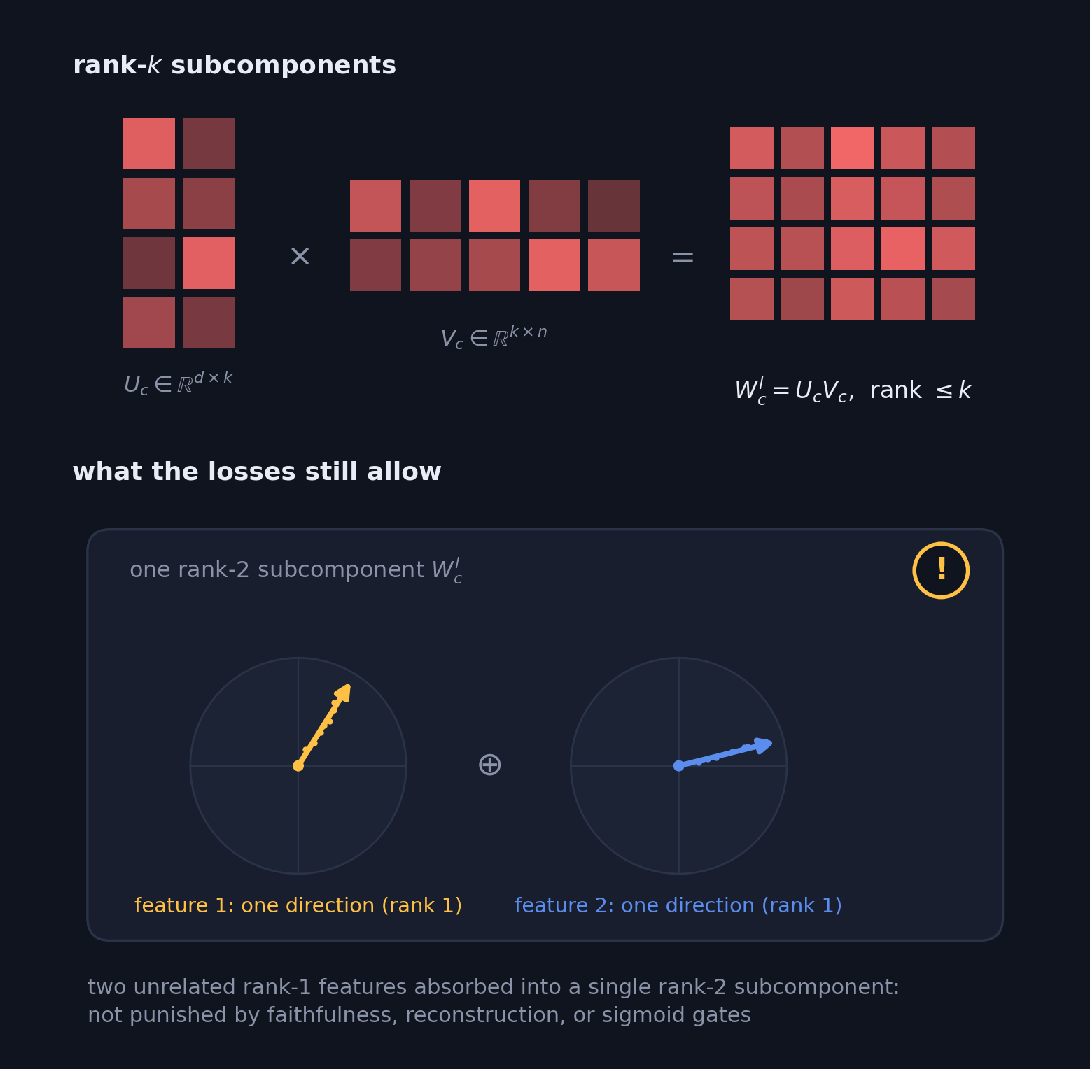

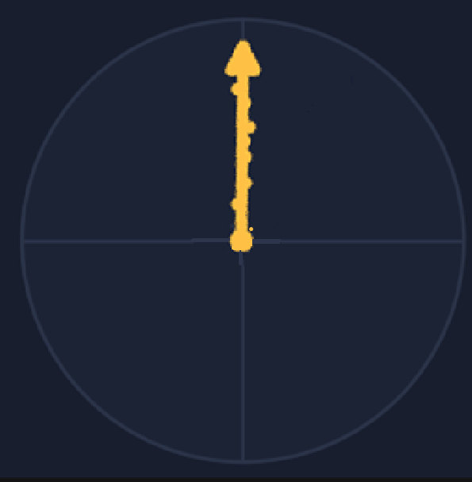

What this thesis explores: rank-k subcomponents
Replace the outer product by a low-rank matrix multiplication per subcomponent:
W^{l}_{c} = U_{c}V_{c}, rank(W^{l}_{c}) ≤ k
The losses are indifferent to how features are split across subcomponents:
Faithfulness: only constrains the sum of all subcomponents
Stochastic reconstruction: only constrains the model's output
Minimality: two subcomponents at 0.5 causal importance is equivalent to one at 1.0
For example: Two concepts with disjoint support
Notes:
The thesis change: each subcomponent becomes W^l_c = U_c V_c with inner dimension k, so rank up to k. But notice what the SPD losses actually constrain. Faithfulness only sees the additive sum over subcomponents; stochastic reconstruction only sees the output; and the sigmoid causal-importance gates are evaluated per subcomponent, independently. Nothing in this objective penalises a single rank-2 subcomponent absorbing two unrelated rank-1 features that live on different directions. That degenerate freedom motivates adding a structural pressure.

Slide 10
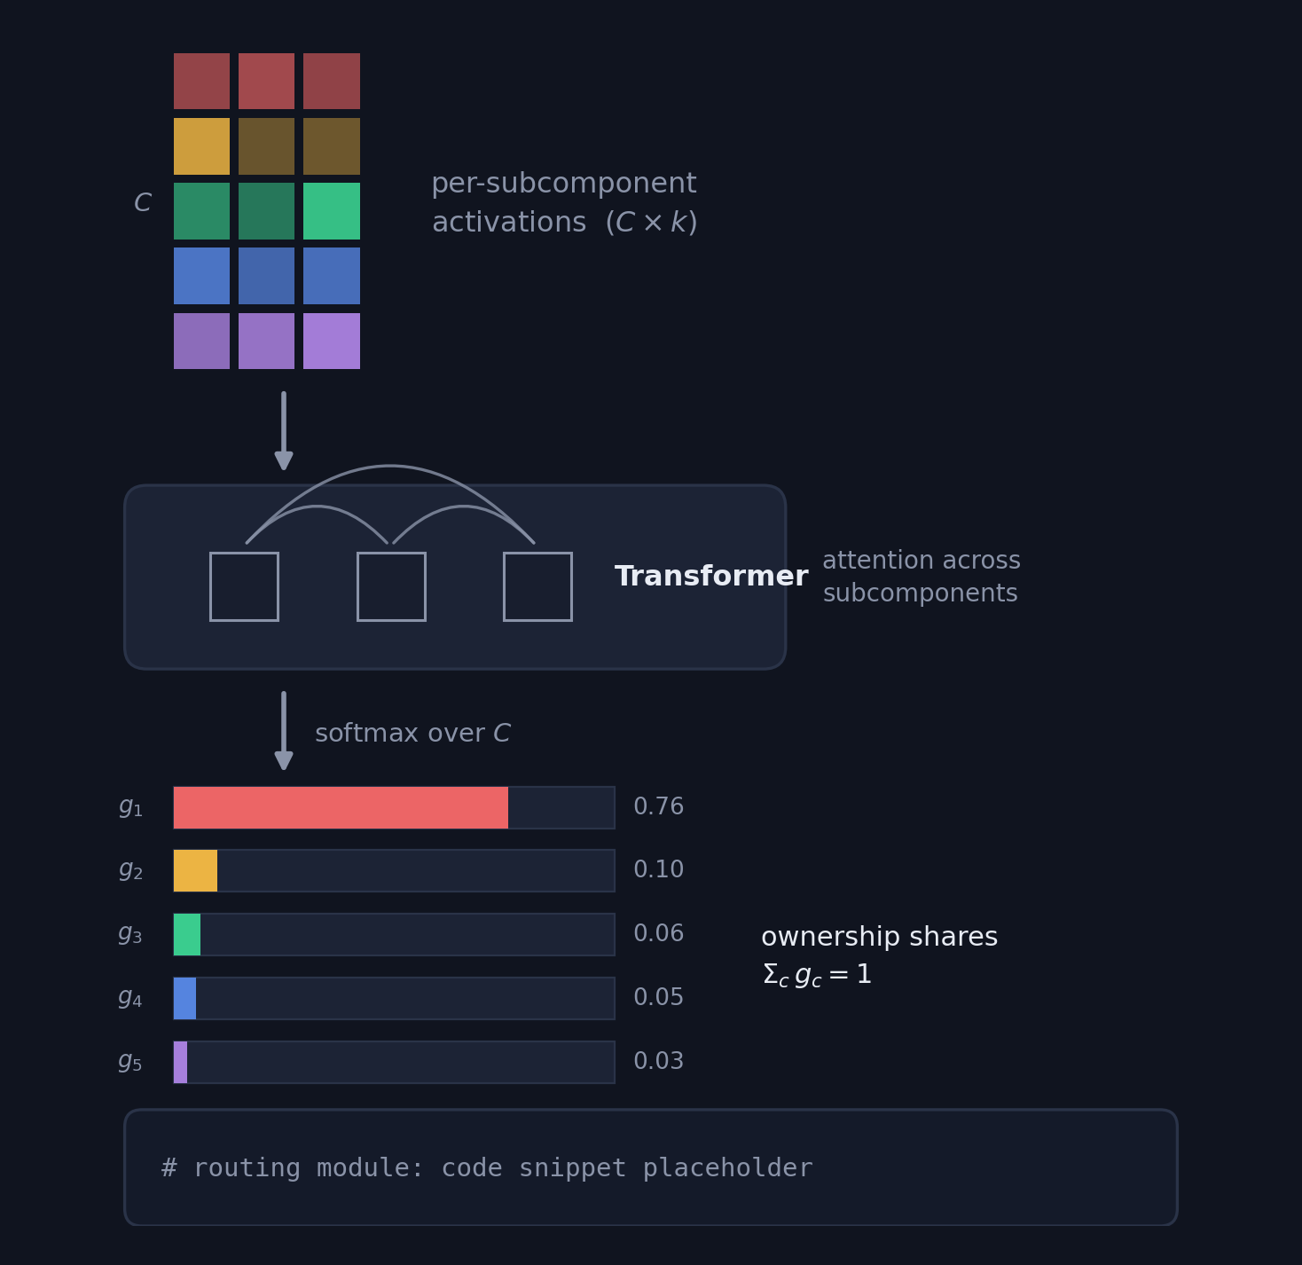

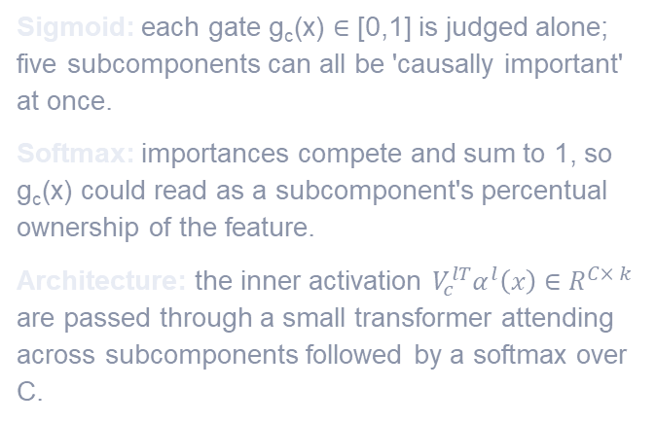
Adding structural pressure: softmax routing
From independent gates to relational ownership
Placeholder: routing matrix figure
(drop your image here)
Sigmoid: each gate g_{c}(x) ∈ [0,1] is judged alone; five subcomponents can all be 'causally important' at once.
Softmax: importances compete and sum to 1, so g_{c}(x) could read as a subcomponent's percentual ownership of the feature.
Architecture: the inner activation $V_{c}^{lT}α^{l}\left(x\right)∈R^{C× k}$ are passed through a small transformer attending across subcomponents followed by a softmax over C.
Placeholder: importance values figure
(drop your image here)
Notes:
The structural pressure: replace independent sigmoid gates with a softmax across the C subcomponents. Importance becomes relational: how important one subcomponent is directly trades off against the others, and the distribution normalises to 1, which reads as percentual ownership of a feature rather than a set of independent yes/no gates. Architecturally, the router takes the per-subcomponent inner activations, a C x k matrix treated as C tokens of dimension k, passes them through a small transformer attending across subcomponents, and softmaxes the resulting scores. Right side: drop in your routing matrix figure (top) and importance values figure (bottom); the code box on the left is editable text for the Router module.

Slide 11
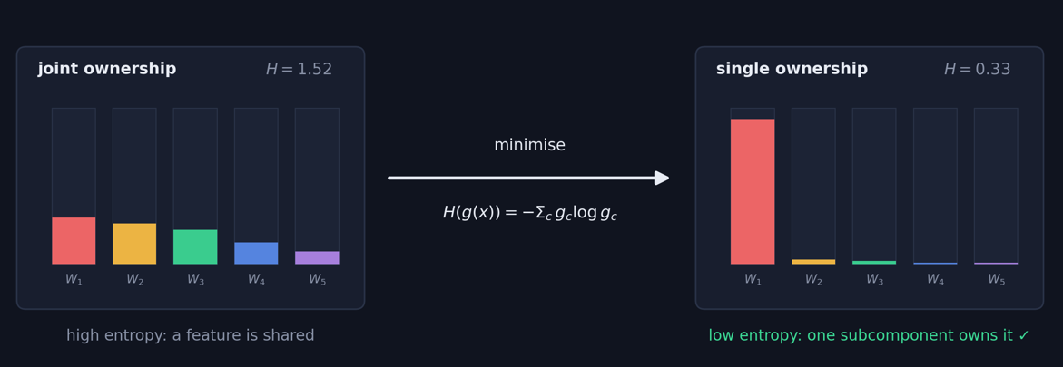
Softmax incompatible with SPD’s minimality loss
Minimality loss becomes degenerate: Under Softmax, Σ_{c} g_{c}(x) = 1 by construction, so the original minimality loss is constant and can no longer prefer sparse solutions.
New loss term: Entropy concentrates importance, shifting joint ownership onto a single subcomponent.
Notes:
With softmax routing, the importances always sum to one, so the old importance-minimality loss is (for p=1) literally constant: it has become degenerate and provides no gradient toward sparsity. The replacement is entropy minimisation: H(r) = -Sigma r_c log r_c. Low entropy means the ownership distribution is concentrated; minimising it pushes shared, joint ownership of a feature onto a single subcomponent, restoring the pressure that minimality used to provide, but in the relational, normalised setting.

Slide 12
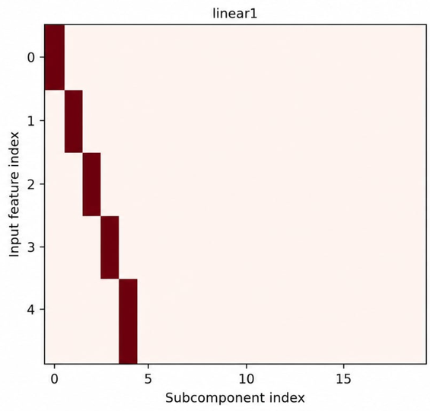
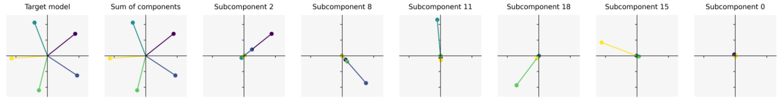
Find 1: one-hot importance, shared reconstruction
In TMS 5-2 the assignment is one-hot, yet no subcomponent reconstructs alone
One-hot assignment: RSPD on TMS 5-2 assigns each feature to a single subcomponent.
But: a subcomponent does not reconstruct the entire feature by itself; only the sum over subcomponents does.
Notes:
First issue with the routed importance reading. On TMS 5-2 the importance matrix (right) is perfectly one-hot: one subcomponent per feature. But the strip below shows that a single subcomponent's output does not reconstruct its feature on its own; only the sum over subcomponents does. So a one-hot importance does not mean sole responsibility for the computation, and the percentual-ownership reading is misleading.

Slide 13
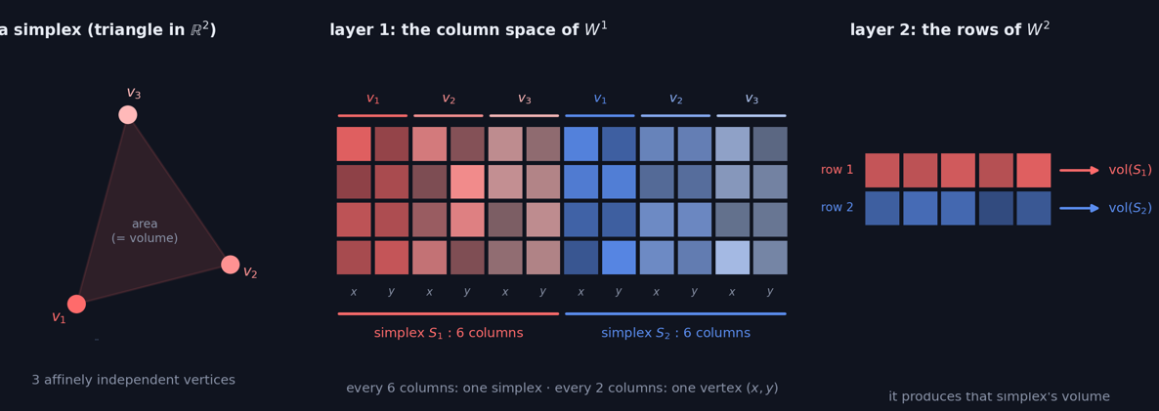







The toy model of geometry
What: compute the volume of an n dimensional simplex; here triangles in ℝ².
How: A 2 layer neural network with a ReLU nonlinearity. The hidden dimension is much larger than the input dimension.
Why: Computation cannot be compressed to a rank 1 direction in the target model.
Notes:
The testbed for higher rank, now with its structure made explicit. Left: a simplex is a set of n+1 affinely independent vertices, vertices that never lie on a common lower-dimensional plane; here triangles in R^2, and the model's task is to output each triangle's area (its volume). Middle: how this lives in the column space of layer 1: every 6 columns correspond to one simplex, and within those, every 2 columns to one vertex (its x and y coordinate). Right: in layer 2, every row is responsible for the output of one simplex's volume. So the ground-truth decomposition assigns each simplex a distinct, multi-directional set of subcomponents, which is exactly what makes this model a probe for rank-k decompositions.

Slide 14
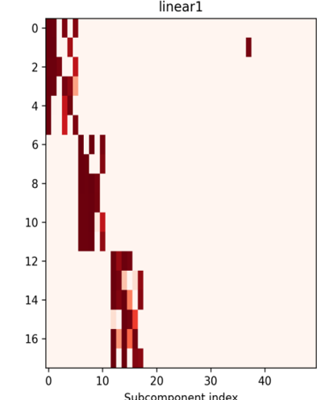
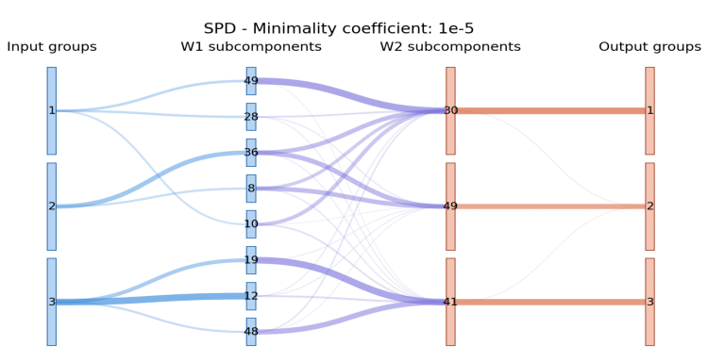
Find 2: SPD on the toy model of geometry
A clear clustering structure, but only inferable by knowing the ground truth (Triangles in R2)
Decomposition with SPD: clear clustering structure across subcomponents at rank 1.
The catch: the structure is only inferable by knowing the task; individual coordinates are shared across multiple subcomponents.
Notes:
First findings slide. Running plain SPD on the toy model of geometry: the Sankey (left) shows a clear clustering structure in how input groups route through W1 and W2 subcomponents to output groups, and the importance matrix (right) confirms it. The catch: the clustering is only legible because we know the task structure; individual subcomponents are responsible for different coordinates of a vertex rather than for a whole concept.

Slide 15
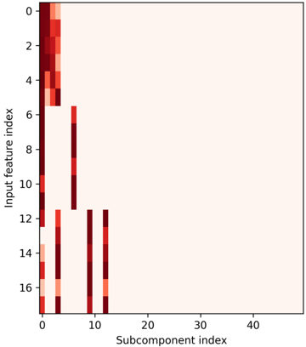
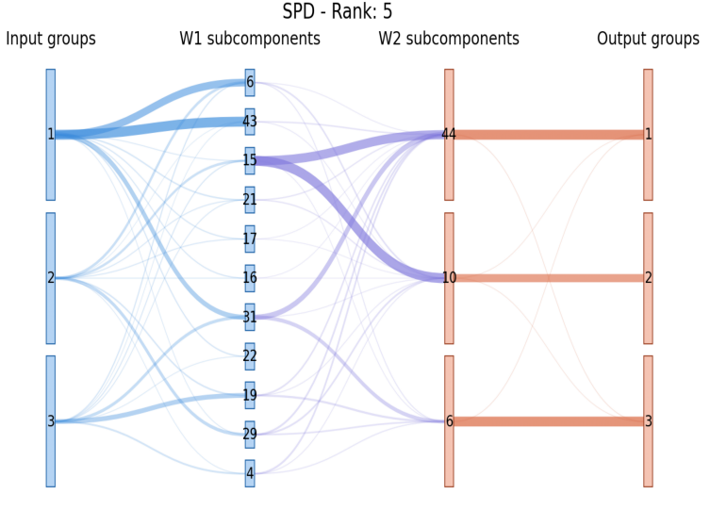
Find 3: Extending SPD to rank 5
Importance collapses, the norm does not?
As hypothesized: subcomponent importance collapses onto fewer subcomponents, each causally important for multiple simplices.
Norm is not constrained to these components: The causally importants do not alone contain 80% of the layer norm.
Notes:
Raising the rank without further pressure. Importance does collapse onto fewer subcomponents, as hypothesized, and those subcomponents become causally important for many nominally different concepts (Sankey, left). But the parameter norm does not follow: rather than concentrating in the causally important subcomponents, many components retain residual norm (heatmap, right). Second issue: the importance values cannot be read as a percentual assignment of the computation.

Slide 16
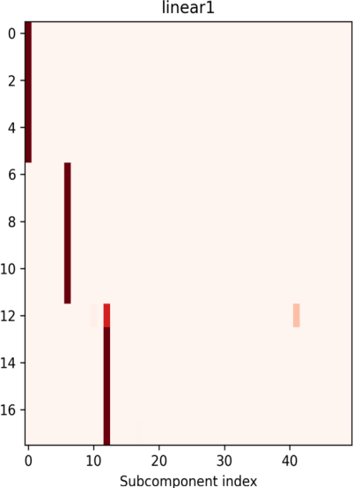
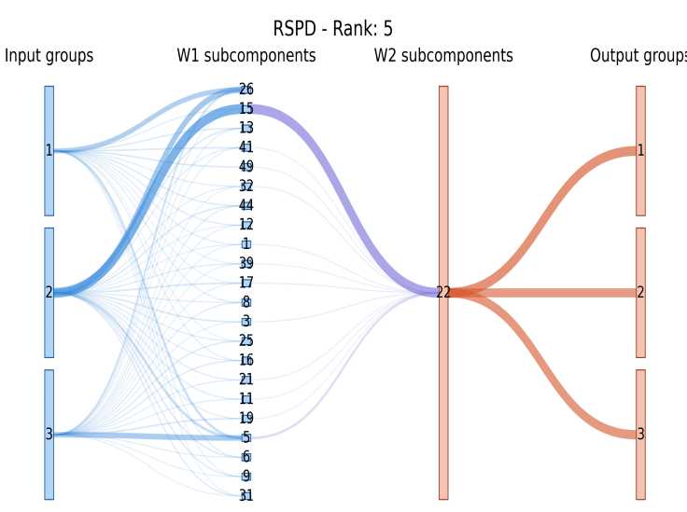
Find 4: RSPDs importance structure
Rank increase: a single subcomponent is causally important for the entire simplex.
The expectation: routing an input through only the causally important subcomponents should reconstruct on its own. It is still off by a fair margin.
Observation: Many subcomponents are required to sum up to the total layer norm, whereby causally unimportant subcomponents must still contribute meaningfully.
Notes:
RSPD with sufficient rank delivers the structure we asked for in the importance assignment: one subcomponent causally important for an entire concept (Sankey, right, where everything routes through a single W1 subcomponent). But the sanity check fails by a fair margin: sending an input through only the causally important subcomponents does not reconstruct alone. The causally unimportant subcomponents are still translating meaningful signal, when the important ones should carry the majority of the norm.

Slide 17
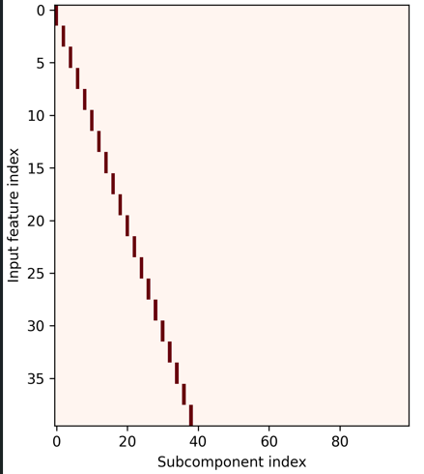
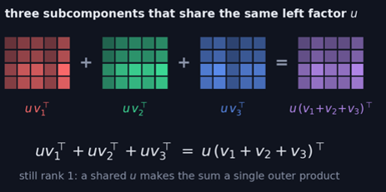
Find 5: Is rank 1 minimal?
Shared directions become shared subcomponents
Paired TMS: the model learns to align multiple inputs onto the same direction.
Decomposition structure: both RSPD and SPD align the inputs onto the same rank-1 subcomponent.
Concurrent work: finds the same phenomenon, where features with disjoint support are grouped in the same subcomponent.
One rank 1 subcomponent causally important for all three, with no incentive to split into these parts.
Notes:
Closing observations from the paired regime. The trained paired TMS aligns multiple features onto the same direction; both SPD and RSPD then assign those features to the same subcomponent, even when they could be separate concepts that merely co-occur. Concurrent work reports the same phenomenon in the cleaner case where the concepts have disjoint support.

Slide 18
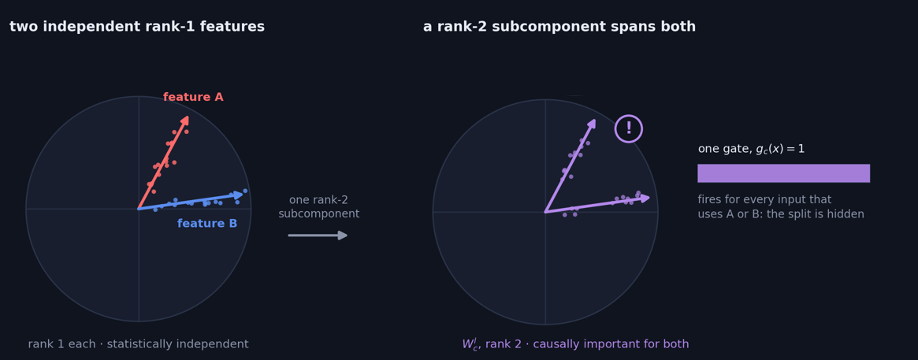

Broader rank ambiguity
Occupancy: the rank a subcomponent can capture also ties into how much it can occupy.
The risk: a rank-2 subcomponent can learn the basis of a 2-D subspace and be causally important for everything within it, even two independent rank-1 features.
Back to rank 1?: Not a solution, as the concurrent work shows it can happen even at rank 1..
Notes:
The rank-capacity trap. Raising the rank gives expressive power but also occupancy: a rank-2 subcomponent can learn the basis of an entire 2-D subspace and become causally important for everything inside it. The diagram shows the failure: two genuinely independent rank-1 features A and B (left) get absorbed into one rank-2 subcomponent that spans both (right), with a single gate g_c(x)=1 firing for every input that uses either, so the underlying split is hidden. Going back to rank 1 does not fix it: separate features placed on the same rank-1 direction still collapse together, and rank 1 cannot represent multidimensional features at all.

Slide 19
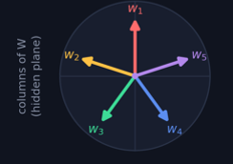
Future work:
My initial idea: Apply reducibility conditions to define when a layer should be split. This gives a dimensional constraint: TMS 5-2 must be partitioned into 5 concepts, but reducibility allows at most 2.
Reducibility conditions + SPD: Apply modified reducibility conditions to disentangle the subcomponents that (V)SPD finds.
In clustering, mixture condition to see if a higher rank subcomponent is in its simplest form?
Pursuing higher rank during training: Other forms of structural pressure and ways to determine the right rank for the task.
Notes:
The reducibility idea, and why the naive version fails. Taking the whole layer as the feature to split gives only a dimensional constraint: in TMS 5-2 the hidden layer is 2-dimensional, so reducibility can split it into at most 2 parts, while the ground truth needs 5 concepts. A modified use would let the conditions choose where to cut a layer into subcomponents, via the two tests: independence and mixture. The figure shows the construction the mixture test must handle: one subcomponent W_c written as two copies at different brightness, a*W_c and (1-a)*W_c. In feature space this is two magnitudes along one direction, exactly a mixture, simulating two subcomponents at different magnitude.

Slide 20

